Slide 1
Navigation & Location Module Testing in Android Automotive
GROUP 5
NAMES | TOPICS
PRINCE | Introduction,
JYOTISMAN | Map rendering,offline maps
DEEPAK | Flow chart , conclusion
SUMA | Key testing
USHA | Route relocation,Integration

Slide 2
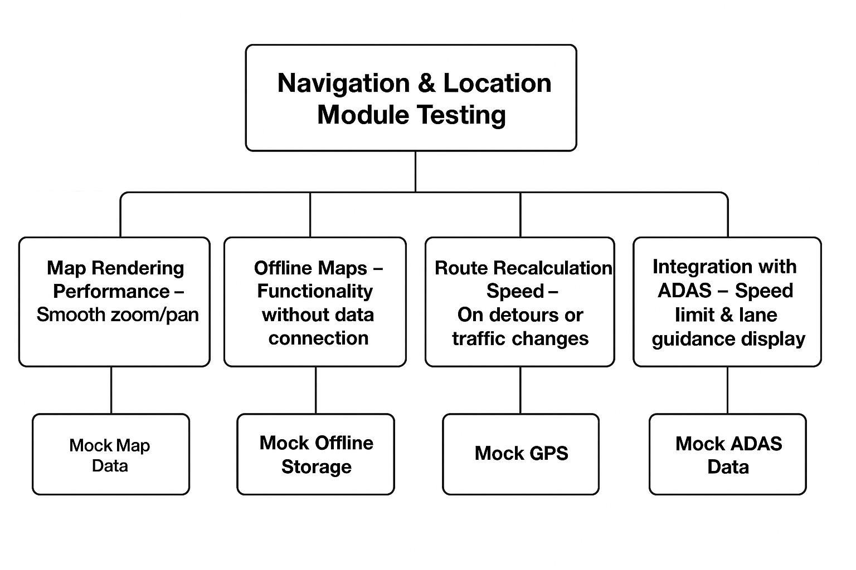
INTRODUCTION
Definition: Module testing = Testing individual functional components in isolation before integration.
Focus in Android Automotive: Navigation modules (apps + system services like LocationManager, Car Navigation Service).
Goal: Ensure each module works optimally before full system testing.

Slide 3
Map Rendering Performance – Smooth Zoom/Pan
Objective: Verify smooth display, zoom, and pan without lag.
Testing Focus:
Isolate rendering engine (OpenGL/Map SDK) from routing logic.
Measure FPS under different zoom levels.
Validate tile loading during fast panning.
Simulate heavy loads (overlays, traffic layers).
Tools:
Android Profiler (GPU profiling)
UI Automator/Espresso for gestures
adb shell dumpsys gfxinfo for FPS logging

Slide 4
Offline Maps – Functionality Without Data
Objective: Ensure offline navigation works without network.
Testing Focus:
Offline data retrieval from local storage.
Navigation with only GPS active.
Error handling for unavailable online features.
Approach:
Disable Wi-Fi & mobile data via ADB.
Verify offline route calculation.
Test in multiple preloaded locations.
Special Case: Partial map data removal to check fallback.

Slide 5
Route Recalculation Speed – Detours/Traffic Changes
Objective: Validate routing engine’s recalculation performance.
Testing Focus:
Time from deviation detection to new route.
Accuracy of recalculated routes.
UI stability during recalculation.
Approach:
Simulate GPS jumps via mock locations.
Introduce virtual closures/traffic events.
Measure delay from logs.

Slide 6
Integration with ADAS – Speed Limit & Lane Guidance
Objective: Validate correct ADAS data integration.
Testing Focus:
Correct overlay of speed limit/lane guidance.
Synchronization between ADAS and navigation UI.
Fail-safe handling for missing data.
Approach:
Use simulated ADAS data feeds.
Inject varying speed limits & lane scenarios.
Automated screenshot comparisons.
Tools: Mock GPS & ADAS service modules.

Slide 7
Key Testing Considerations
Isolation: Mock dependencies to test modules individually.
Instrumentation: Use Android instrumentation tests.
Repeatability: Scripted GPS routes & mock data.
Edge Cases:
No GPS lock
Corrupted map data
Sudden ADAS data drop

Slide 8
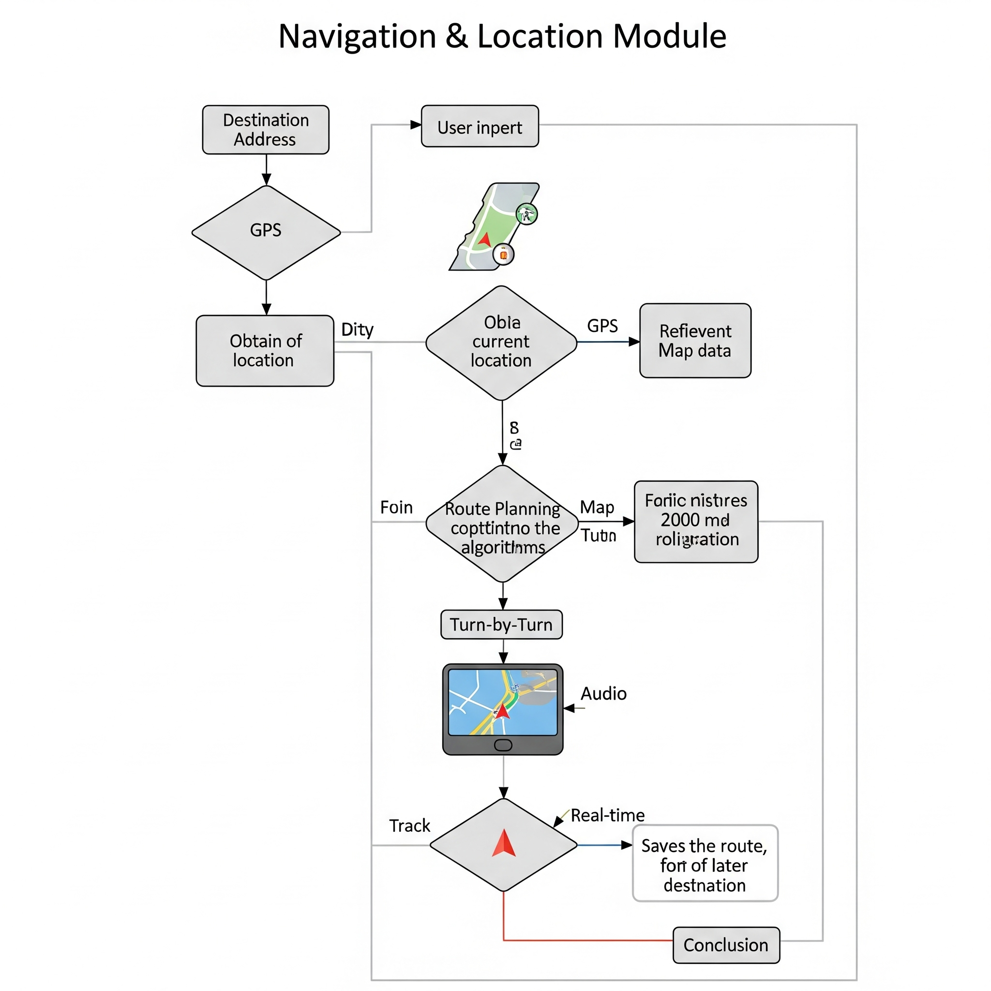
FLOW CHART

Slide 9
Conclusion
Isolated module testing ensures early defect detection.
Improves stability and performance before integration.
Leads to safer and more reliable navigation in Android Automotive.

Slide 10

THANK YOU

